Slide 1
ANL201 – Study Units
Time frame and Deliverables
Study Unit | Topic | Date (2022) | Quiz | Deadlines
1 | Business Performance Management Balanced Scorecard Strategy Map | 05th Feb | Pre-Course Quiz 01* | 24th Jan – 4th Feb
2 | All about Data | 10th Feb | Pre-Class Quiz 01* | 7th Feb – 14th Feb
 |  |  | Tutor Marked Assignment | 16th Feb (by 2355 hrs)
3 | Theory/ Foundation to Visualization | 17th Feb | Pre-Class Quiz 02* - | 21st Feb – 28th Mar
4 | Basic Visualization | 24th Feb |  | -
5 | Advanced Visualization | 3rd Mar | Group Based Assignment | 2nd Mar (by 2355 hrs)
6 | Business Performance Dashboard | 10th Mar | End of Course Assessment | 17th Mar (by noon)
*All quizzes have a 12-NOON deadline. No extensions!

Slide 2
Learning Objectives of ANL201
By the end of this Course
Understand concepts of Business Performance, Measurement, Balanced Scorecard Model and Data Visualization
Compare stages of Data Visualization Process
Data Visualization Components
Design Principles of a Business Performance Dashboard
Appropriateness of Data Visualization techniques based on available data
Appropriates of Business Performance Measure against Business Strategy of Organization
Required Textbooks:
Yau, N,.(2013). Data Points: Visualization that Means Something
Murray, D. G. (2013). Tableau Your Data

Slide 3
Visualisation for Business ANL 201
The Art of Data Visualisation Study Unit 3
January 2022

Slide 4
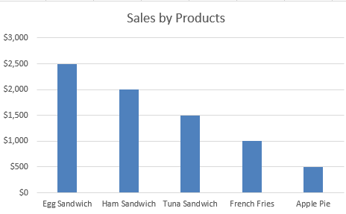
Four Components of Data Visualisation
Four components of Data Visualisation are Visual Cues, Coordinate Systems, Scales and Context (Yau 2013).
These four components work together and each of them affects the other.
Context Cue
Simplest Form – mapping data onto geometry and colour
Human beings are naturally hardwired to find patterns
Coordinate System
Scales
Visual Cue
Scales

Slide 5
Visual Cues

Slide 6
Visual Cues
The components of visual cues
Position (e.g., scatterplot)
Length (e.g., bar chart)
Angle (e.g., pie chart)
Direction (e.g., line graph)
Shape (e.g., scatterplot)
Area and Volume (e.g., square area graph)
Colour
Visual Cues to choose from depend on data & business objectives

Slide 7
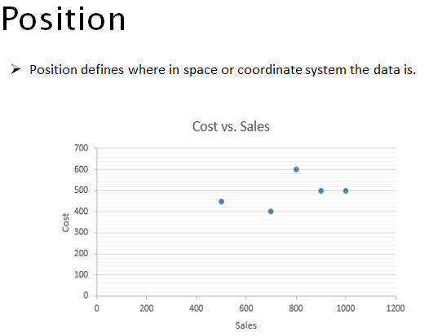
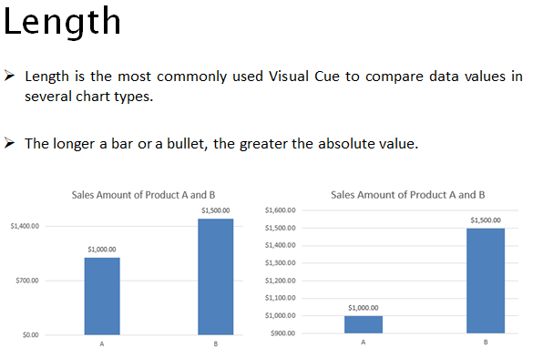
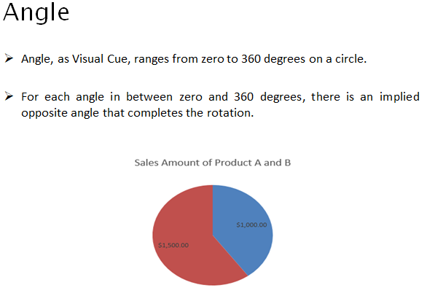
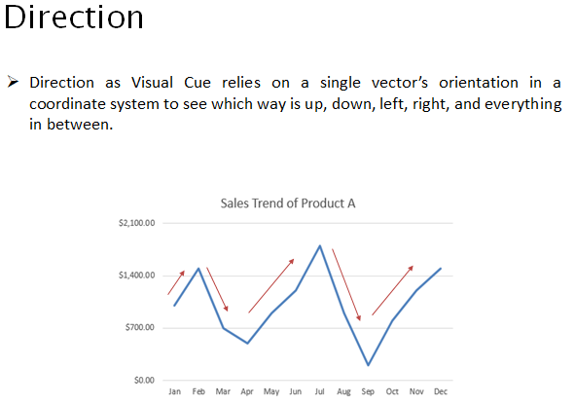
Visual Cues
Each data point represented by symbol taking up the same amount of space; however, hard to sometimes read the data
Works in both vertical or horizontal direction.
Pay attention to the axis; absolute lengths could be misleading
Pay attention to the axis; absolute lengths could be misleading
Notes:
By using Position Visual Cue, we can spot trends, clusters and outliers by plotting a lot of data points within the x and y planes. However, it will be challenging to identify what each data point represents.

Slide 8
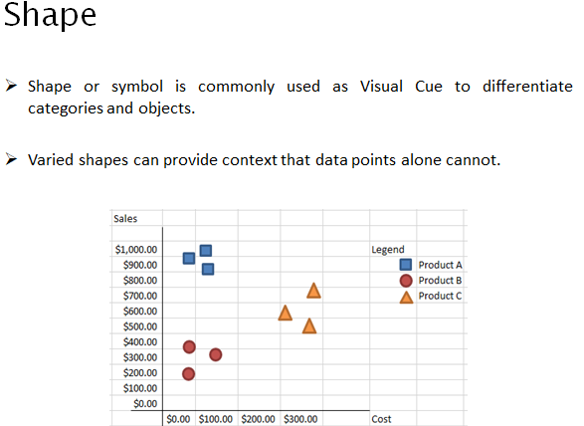
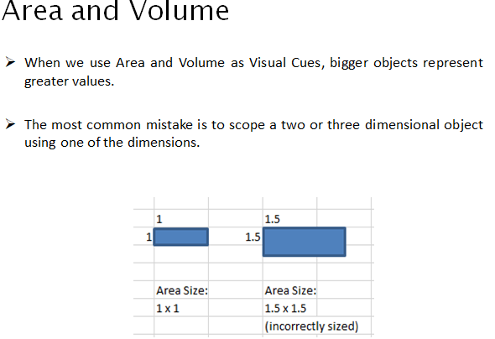
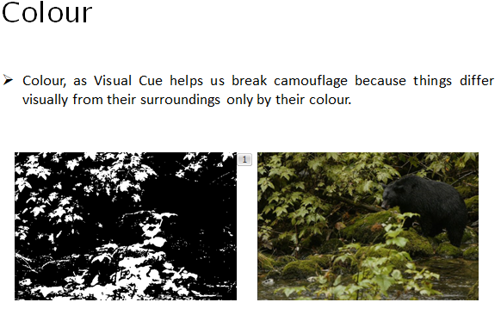
Visual Cues
(Assume all units are m²) Area of Square = 1
Increase area by 50%; area of new square = 1.5
Since it’s a square, the length of each side = SQRT(1.5) = 1.2222
Shapes can add a 3rd dimension to the interpretation of the data
Colour is good for labelling and categorisation, but poor for displaying shape, detail or space

Slide 9
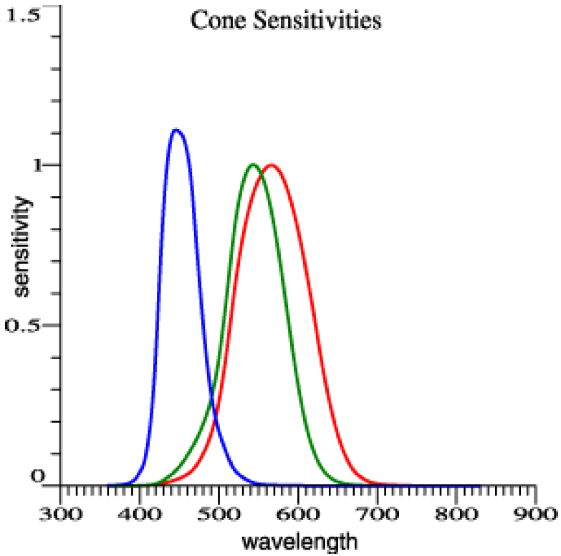
Visual Cues
Colour — the Red-Green-Blue (RGB) colour system
The basic idea of the RGB colour system is that any coloured light can be matched by a weighted sum of any three distinct primary colours
C ≡ rR + gG + bB,
where C is the colour to be matched R, G, and B are primary sources to be used to create a match r, g, and b are the amounts of each primary source ≡ denotes a perceptual match
Normal Vision
1 collapsed frequency
Colour Blind Vision (deficiency is always R G)
Normal Vision
Notes:
RGB is an additive color model. It means that different proportions of Red, Blue and Green light can be used to produce any color. The RGB color model was created specifically for display purposes (display screens, projectors etc).

Slide 10
Visual Cues
Colour — the Red-Green-Blue (RGB) colour system
Colourimetry – intensity (objective) as opposed to the brightness (subjective)
Intensity: amount of light (lumens) falling on a surface (over any given square foot or square meter). Therefore, light intensity is measured in terms of lumens per square foot (footcandles) or lumens per square meter (lux)
Theoretically, you can match the overlapped RGB with test colours.
Practically, not easy because difficult to standardized the primary lamps and keep in calibrated

Slide 11
Visual Cues
Colour — the CIE colour system
The CIE colour system uses a set of abstract primaries called tristimulus values that are labelled XYZ. These values are chosen for their mathematical properties, and not because they match any set of actual lights
The CIE colour system is by far the most widely adopted colour system to measure coloured lights. We should always use the CIE colour system when precise colour specification is required
Notes:
CIE 1931 XYZ was the first attempt to produce a color space based on measurements of human color perception and the basis for almost all other color spaces.
One important CIE standard from around 1931 basically calibrated human tristimulus (RGB) color vision spectral sensitivity.

Slide 12
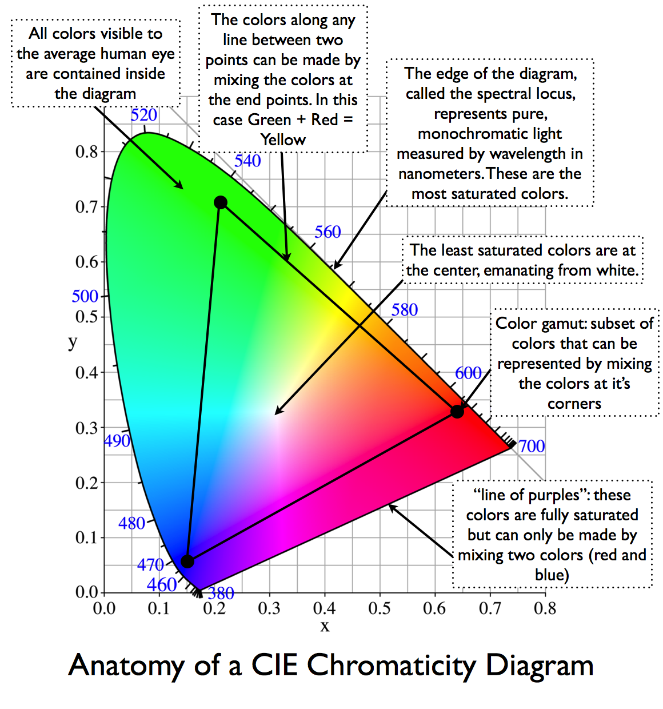
Visual Cues
Colour — the CIE colour system
Source: https://dot-color.com/tag/chromaticity-diagram/

Slide 13
Visual Cues
Colour — the HSV colour system
The HSV colour system uses colour hue, colour saturation, and black-white brightness (i.e., value) to specify the surface colours
In the HSV colour system, hue refers to which part of the rainbow colour map a colour belongs to, such as red or green. Saturation refers to how rich a colour hue is, for example, neon colours are very saturated, while pastel colours are less saturated. Value denotes how bright a colour is, or in other words, how close a colour is to pure white or pure black
This colour system is often used by artists
Notes:
HSV
A computer graphics student can get fuddled if he/she has been given only Red, Green and Blue lights to create complex shades. For example, what combination should I use to get this exact amount of greenish blue? How should I make it appear "lighter" or more "whiter"? How much of Red should I add to make it appear more "natural"?
For stuff like this, folks came up the HSV space. This space transforms the RGB space into a more convenient representation.
Can you observe the difference? The "Whiteness" / "lightness" is a function of R, G and B. However, when we view it in the cube, there is a separate dimension known as Value (V) dedicated towards “Whiteness”.
In the RGB cube, the Saturation or "colorfulness" is given by the distance of your color from the 3D diagonal. In the HSV model however, the Saturation is directly given as another dimension.
Conclusion: For certain applications, we require a better representative model of color and hence, we have the HSV space.

Slide 14
Visual Cues
Colour — the HSV colour system
Hue – which part of rainbow colour map a colour belongs to i.e., reg to green
Saturation – how rich a colour hue is e.g., neon colours are saturated, while pastel colours are less
Value denotes colour brightness, or how close it is to black or white
What combination should I use to get greenish blue?
How should I make it appear "lighter" or "whiter"?
How much Red should I add to make it appear "natural"?
HSV space transforms the RGB space into a more intuitive representation.
For certain applications, we require a better representative model of color and hence, we have the HSV space.

Slide 15
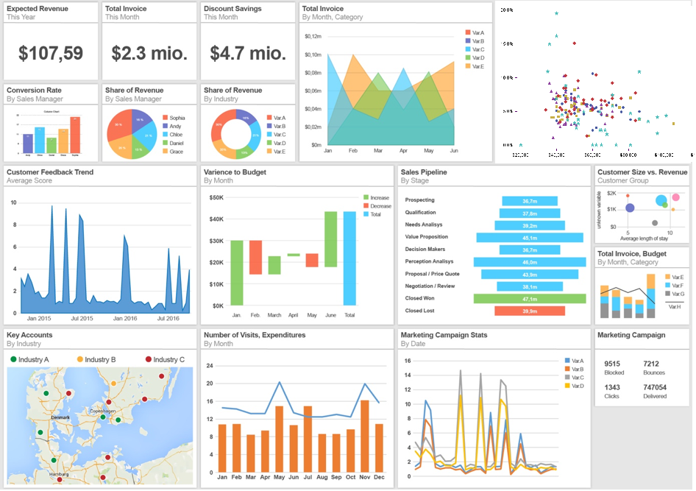
Class Discussion 1
Can you identify the components of visual cues on the dashboard ?
Source: https://dapresy.com/wp-content/uploads/2016/07/Image-4.png;
http://www.sas-sr.com/intro_sas/mercredi/major.PNG

Slide 16
Class Discussion 1
Can you identify the components of visual cues on the dashboard ?
Colour
Shape
Angles
Length
Area and Volume
Position
Direction
Source: https://dapresy.com/wp-content/uploads/2016/07/Image-4.png;
http://www.sas-sr.com/intro_sas/mercredi/major.PNG

Slide 17
Coordinate Systems
(15 mins break)

Slide 18
Coordinate Systems
The cartesian coordinate system
The cartesian coordinate system specifies each data point on a plane by a pair of numerical coordinates. The numerical coordinates are the signed distances from the data point to the two fixed perpendicular reference lines, called the x-axis and y-axis
Both axes meet at a point, called the origin, which is usually represented by the ordered pair (0, 0)
The numerical coordinates can also be expressed as a signed distance from the origin

Slide 19
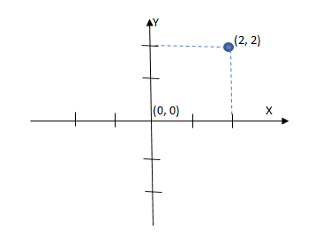
Coordinate Systems
The cartesian coordinate system
Each data point in a plane represented by a pair of (numerical) coordinates.
Length and magnitude of line
Origin
Notes:
Cartesian Coordinate System is a coordinate system that specifies each data point in a plane by a pair of numerical coordinates.
The numerical coordinates are the signed distances from the data point to the two fixed perpendicular reference lines which are measured in the same unit of length. These reference lines are called x- axis and y-axis. Both axes meet at a point, called origin, which is usually represented by ordered pair (0, 0). The numerical coordinates can also be expressed as a signed distance from the origin.

Slide 20
Coordinate Systems
The polar coordinate system
In the polar coordinate system, each data point is determined by the distance between a fixed point and an angle from a fixed direction
The fixed point, which is analogous to the origin in the cartesian coordinate system, is called the pole. The ray or half-line from the pole in the fixed direction is called the polar axis. The distance from the pole is called the radial coordinate or radius, and the angle is called the angular coordinate, polar angle or azimuth

Slide 21
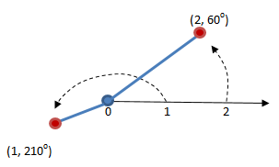
Coordinate Systems
The polar coordinate system
Distance from the pole is called the radial coordinate
Angle is called the angular coordinate, polar angle or azimuth
Polar Axis
Pole
Notes:
Polar Coordinate System is a two-dimensional coordinate system. Each data point is determined by the distance between a fixed point and an angle from a fixed direction. The fixed point, which is analogous to the origin in the Cartesian Coordinate System, is called the Pole. The ray or half-line from the Pole in the fixed direction is called the Polar Axis. The distance from the Pole is called the Radial Coordinate or Radius, and the angle is called the Angular Coordinate, Polar Angle or Azimuth.
This coordinate system is less used than the Cartesian Coordinate System, but it is useful in cases where the angle or direction is important.

Slide 22
Coordinate Systems
The geographic coordinate system
The geographic coordinate system enables every location on the earth to be specified by a set of numbers or letters. To represent the location, the coordinate system commonly uses latitude and longitude. Sometimes the coordinate system may also use elevation
Latitude lines run east and west, which indicates north and south positions on the globe. Longitude lines run north and south, which indicates east and west positions. Elevation can be thought of as a third dimension
Latitude = Horizontal = x-axis
Longitude = Vertical = y-axis

Slide 23
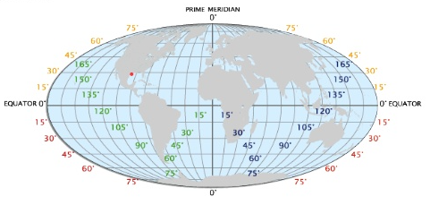
Coordinate System
The geographic coordinate system
Source: http://image.slidesharecdn.com/projectionsandarcgis-131008191137-phpapp01/95/understanding-coordinate-systems-and-projections-for-arcgis-4-638.jpg?cb=1381259844
Notes:
The surface of the Earth is wrapped around a spherical mass, but we usually want to display a location on Earth on a two-dimensional surface, like a piece of paper or a computer screen. Therefore, there is a variety of ways to map the surface of the Earth on a two-dimensional surface, which are called projections.

Slide 24
Coordinate Systems
The geographic coordinate system — projections (1/4)
The surface of the earth is wrapped around a spherical mass, but we usually want to display a location on earth on a two-dimensional surface, like a piece of paper or a computer screen
Therefore, there is a variety of ways to map the surface of the Earth on a two-dimensional surface, which are called projections

Slide 25
Coordinate Systems
The geographic coordinate system — projections (2/4)
Equirectangular — typically used for thematic mapping and it does not preserve any area or angle
Albers — does not preserve scale and shape, and angle is minimally distorted
Mercator — preserves angles and shapes in small area, so it is good for direction
Notes:
You can briefly touch upon the different type of projections.

Slide 26
Coordinate Systems
The geographic coordinate system — projections (3/4)
Lambert Conformal Conic — better used for showing smaller areas and it is often used for aeronautical maps
Sinusoidal — preserves area and it is useful for showing areas near the prime meridian
Polyconic — used to show the map of the U.S. in the mid-1900s. There are little distortions in small areas near the meridian

Slide 27
Coordinate Systems
The geographic coordinate system — projections (4/4)
Winkel Tripel — a good choice for showing the world map, because it minimises area, angle and distance distortions
Robinson — a good choice for showing the world map because it compromises preserving areas and angles
Orthographic — represents a three-dimensional object in a two-dimensional space. Using this method, the user needs to rotate to the area/location of interest

Slide 28
Scales
(15 min break)

Slide 29
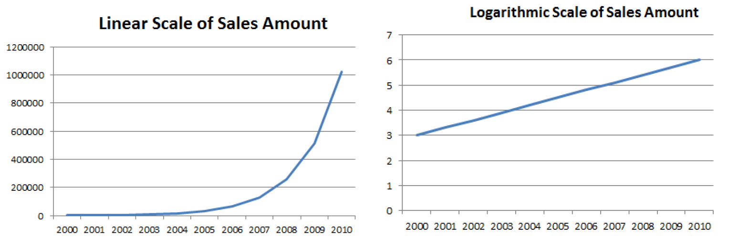
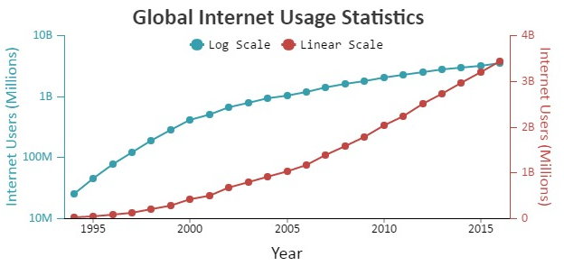
Scales
Comparing the different scales (1/3)
With a linear scale, the visual spacing between each of the data points is the same regardless where the data points are on the axis
The logarithmic scale condenses the distance between each of the data points when the value of the data points increase
A log scale is very useful to show rate of change but best to use it carefully and by explaining to your audience that the graph is in a log-scale
Source: http://canvasjs.com/wp-content/uploads/images/gallery/javascript-chart-logarithmic-axis/html5-javascript-chart-multiple-logarithmic-axis.jpeg

Slide 30
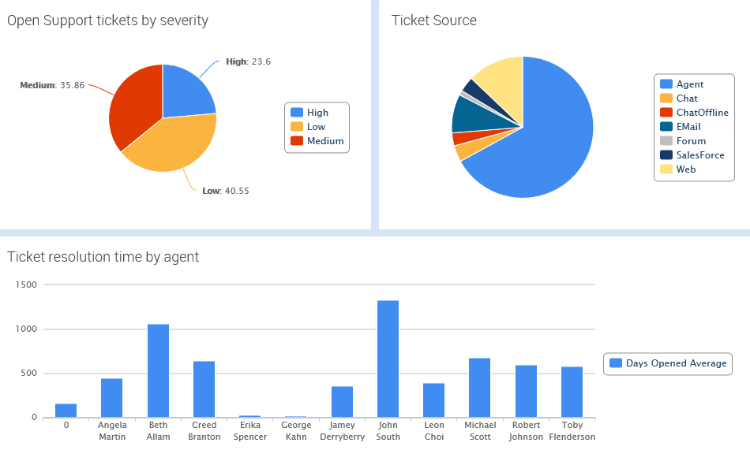
Scales
Comparing the different scales (2/3)
A percent scale is usually linear, but when it is used to represent part of the whole data, its maximum is 100 percent
We use a categorical scale when we want to provide visual separation of categorical data, such as country of residence or gender
Percent Scale
Categorical Scale
Ordinal Scale

Slide 31
Scales
Comparing the different scales (3/3)
We use the time scale when we want to plot temporal data on a linear scale, or to divide the temporal data on a categorical scale, such as by year, month or day
Source: https://s-media-cache-ak0.pinimg.com/originals/06/d2/7c/06d27c4e1d7d594ad5f130dc531d2e56.jpg

Slide 32
Context

Slide 33
Context
The big idea
Context is a data visualisation component that lends to better understanding of who, what, when, where and why of the data. Context can make the data clearer for interpretation
When we would like to enable viewers to see the data visualisation object of primary interest in full detail, and at the same time get an overview within the context (i.e., surrounding information) available, this is known as a focus-context problem in data visualisation

Slide 34
Context
The three premises of the focus-context problem
The viewer needs both context (i.e., overview of the information), and focus (i.e., details of the information) simultaneously
The information needed in the overview may be different from that needed in the detail
These two types of information need to be combined within a single interactive data visualisation

Slide 35
Context
Sub-types of the focus-context problem
Spatial related problems are common to all Data Visualisation that use maps
Structural related problem arises when we try to visualise data that have structural components at many levels
Temporal related problem involves understanding the timing of data at very different scales

Slide 36
Context
Solving the focus-context problem — distortion
The distortion technique spatially distorts a data presentation to give more room to the designated points of interest, and to decrease the space given to regions away from those points

Slide 37
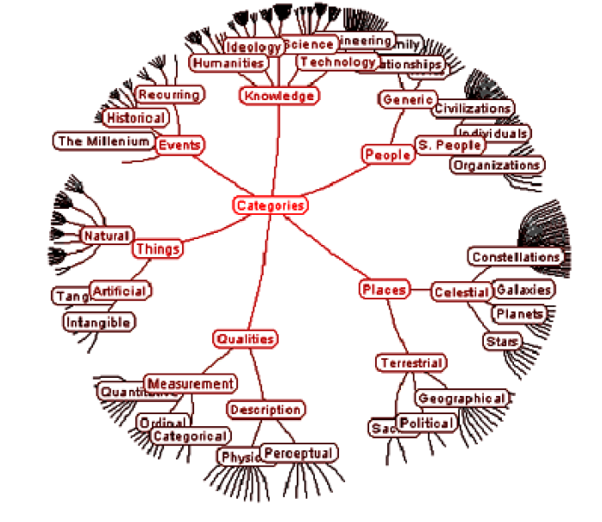
Context
Distortion – Hyperbolic Tree Browser

Slide 38
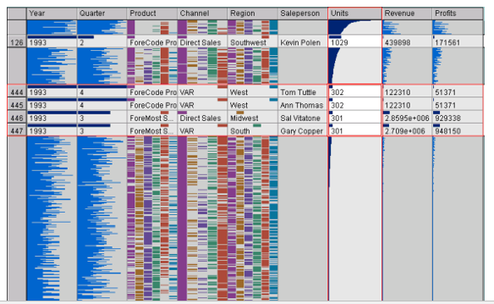
Context
Distortion – Table Lense

Slide 39
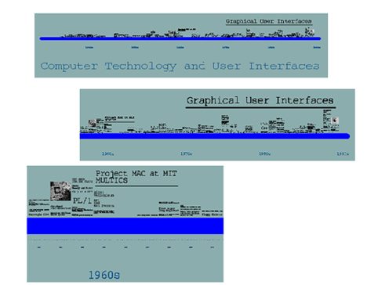
Context
Solving the focus-context problem — rapid zooming
The rapid zooming technique allows viewers to zoom rapidly in and out of points of interest
Pad and Pad++ systems proposed by Bederson and Hallan in their publication in 1994 are examples of the Rapid Zooming technique’s application.

Slide 40
Context
Solving the focus-context problem — elision
The elision technique hides parts of a structure from viewers until they are needed

Slide 41
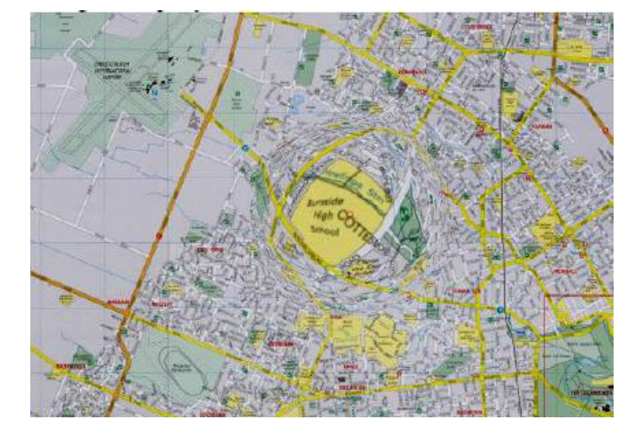
Context
Elision – Fish Eye Technique

Slide 42
Context
Solving the focus-context problem — multiple windows
The multiple windows technique allows viewers to have one window that shows an overview of the data, and several other windows that show the expanded details

Slide 43
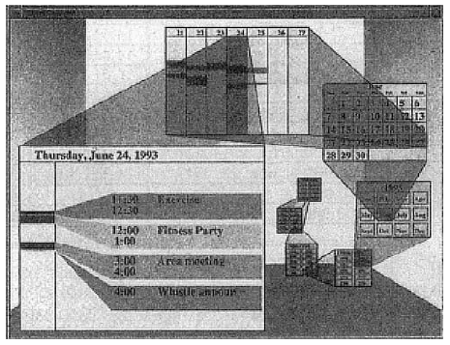
Context
Multiple Windows – Spiral Calendar Method

Slide 44
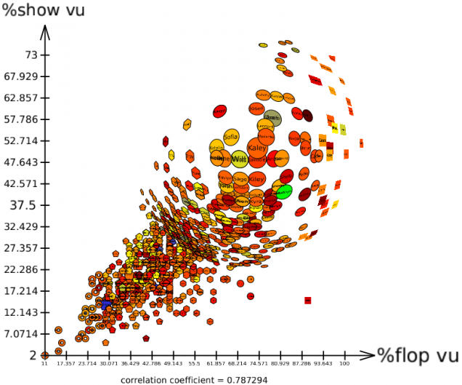
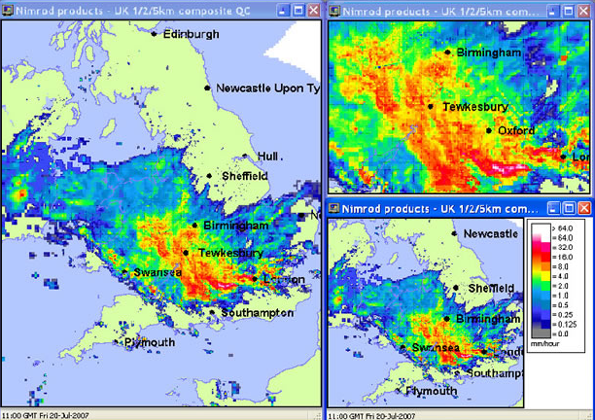
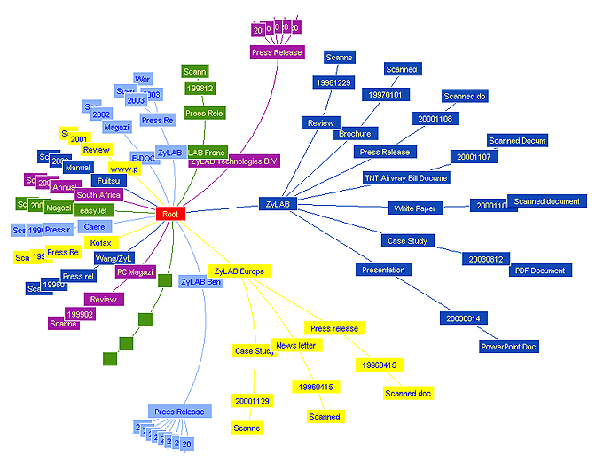
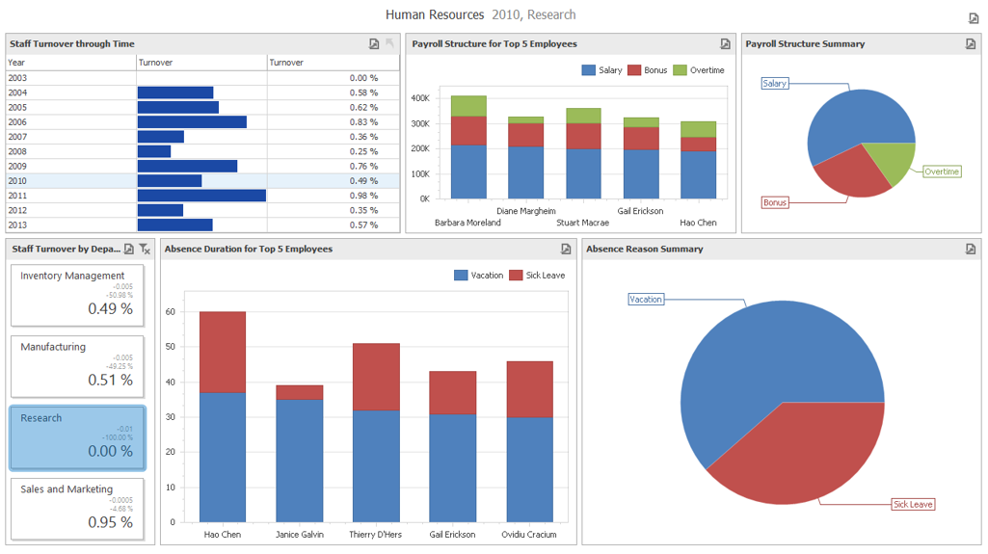
Class Discussion 2
Can you identify the four focus-context data visualisation techniques
(a)
(b)
(c)
(d)
Source: https://zylab.files.wordpress.com/2010/09/hyperbolic_tree.png ;
http://www.ceh.ac.uk/sites/default/files/hyrad-static-and-rapid.jpg ; http://tulip.labri.fr/TulipDrupal/sites/default/files/uploadedFiles/images/scatterplot_view_detail_fisheye.preview.png; https://www.devexpress.com/products/net/dashboard/i/demos/winforms-hr-dashboard.png
Notes:
Rapid Zooming
Elision
Distortion
Multiple Windows

Slide 45
Class Discussion 2
Can you identify the four focus-context data visualisation techniques
(a)
(b)
Rapid Zooming
Elision
(c)
(d)
Distortion
Multiple Windows
Source: https://zylab.files.wordpress.com/2010/09/hyperbolic_tree.png ;
http://www.ceh.ac.uk/sites/default/files/hyrad-static-and-rapid.jpg ; http://tulip.labri.fr/TulipDrupal/sites/default/files/uploadedFiles/images/scatterplot_view_detail_fisheye.preview.png; https://www.devexpress.com/products/net/dashboard/i/demos/winforms-hr-dashboard.png
Notes:
Rapid Zooming
Elision
Distortion
Multiple Windows

Slide 46
Class Activity: Data Visualisation Evaluation

Slide 47
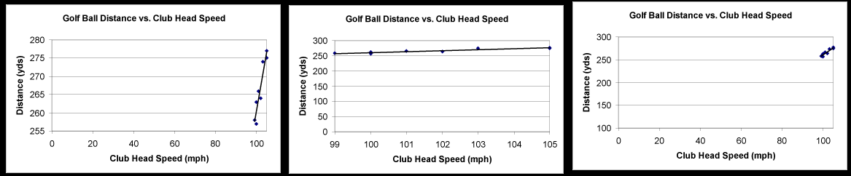
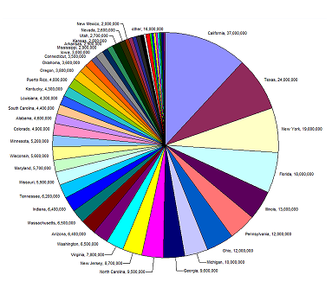
Class Activity Task
Sit with your GBA’s team mates
Discuss why the plots/charts are bad visualisation example and suggest ways to improve the plots/charts.
(a)
(b)

Slide 48
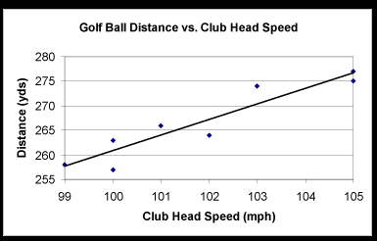
Class Activity Task
(a)
The range of the numerical scale for each axis should be large enough to include all data of interest, but small enough that there aren't large sections of the plot that are empty as the empty space serve no purpose, and have the net effect of compressing the available space for the plotted data. The plot itself should be large enough and neatly drawn so as to be easily legible.
Source: http://www.faculty.virginia.edu/ASTR3130/lablinks/GuidePlots.html

Slide 49
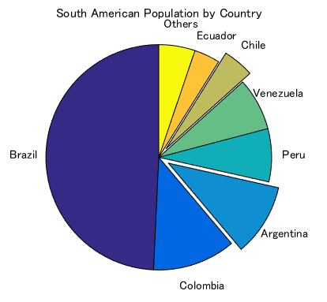
Class Activity Task
(b)
The pie chart shows too many slices which makes it hard for the reader to interpret the data. Simple pie charts displaying 2-3 categories may work just fine, but when displaying more data it is better to choose another chart type.
Source: http://www.eea.europa.eu/data-and-maps/daviz/learn-more/chart-dos-and-donts; http://www.mathworks.com/matlabcentral/mlc-downloads/downloads/submissions/35277/versions/3/previews/html/Pie_Chart_2D_2_01.png

Slide 50
Tableau (Class Activity)

Slide 51
Tableau (Class Activity)
Sit with your GBA’s team mates
Follow your instructor for the following exercises:
Data:
global_superstore_2016.xlsx (orders)
Coffee Chain.xlsx and Office City.xlsx

Slide 52
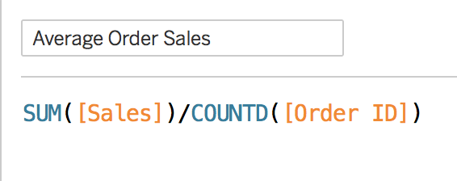
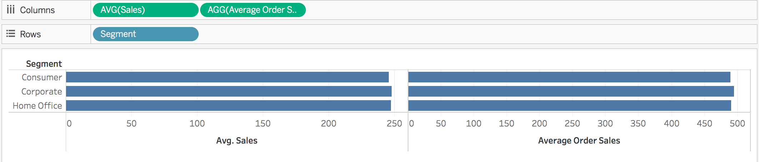
Calculation: Aggregate VS Record-Level
Notes:
Compare AVG and derived aggregated value, SUM/COUNTD sum of sales/number of distinct order
Compare AVG and derived aggregated value, SUM/COUNT sum of sales/number of order

Slide 53
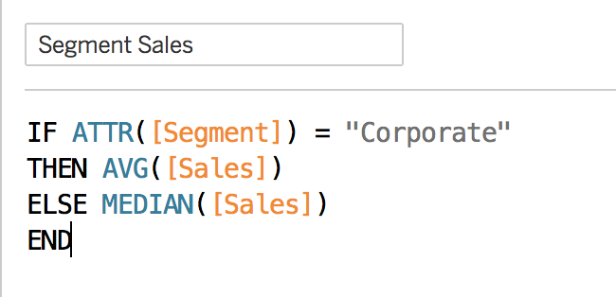
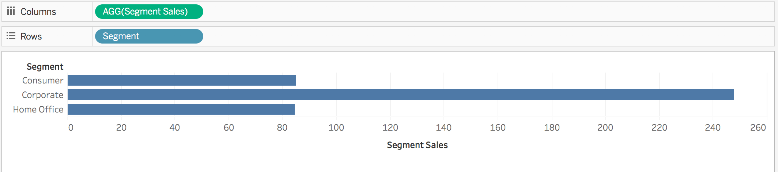
Aggregate Functions
Aggregation of a measure
Aggregation of a dimension
More information:
https://help.tableau.com/current/pro/desktop/en-us/calculations_aggregation.htm
https://help.tableau.com/current/pro/desktop/en-us/calculations_calculatedfields_aggregate_create.htm
Notes:
Part of this exercise is to illustrate the use of calculated field, and introduce students to some basic coding within Tableau.
Go through commonly used agg functions

Slide 54
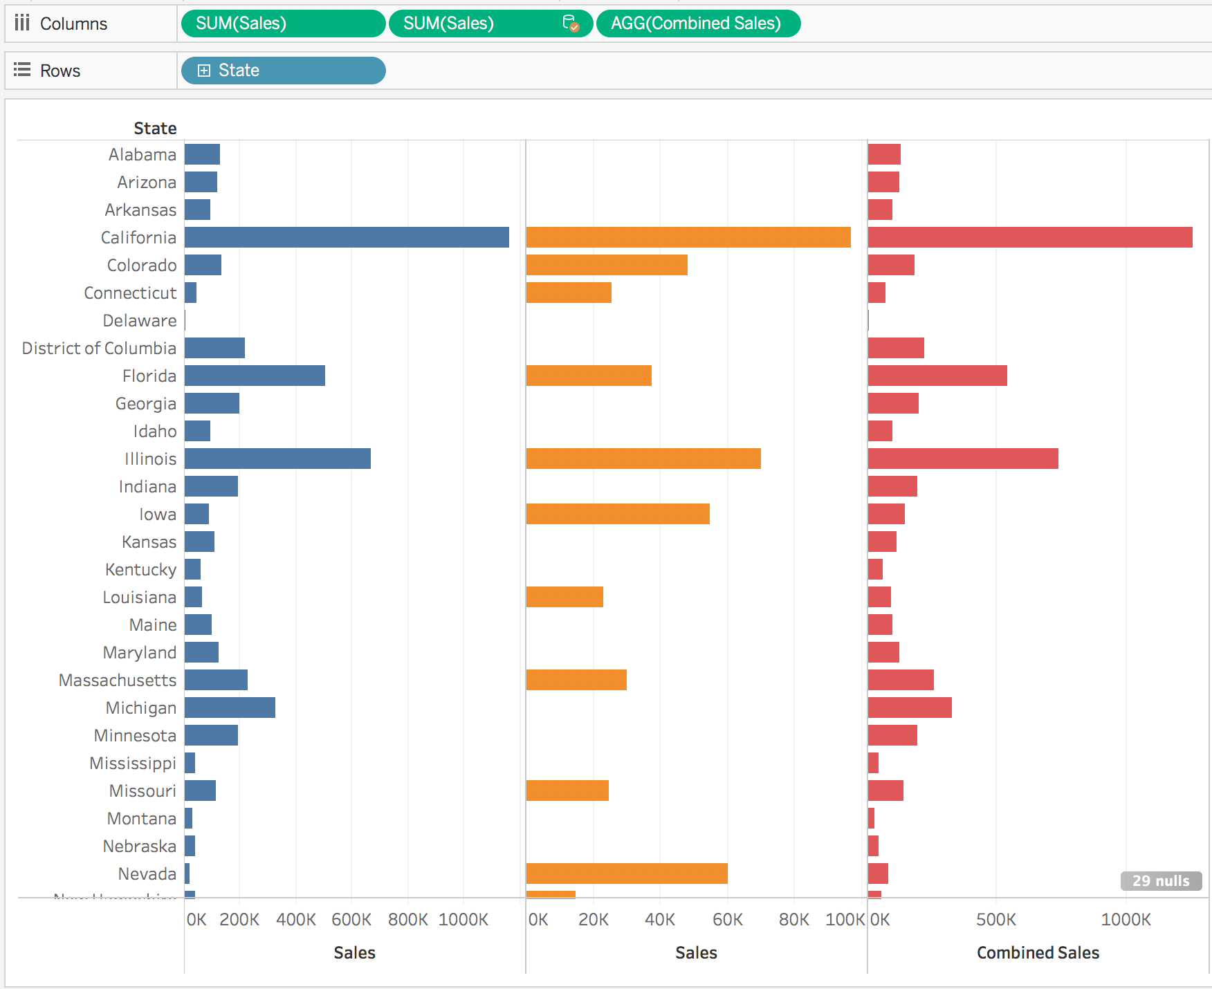
Exercise
Create a calculated field: for each state, calculate combined sales from office city.xlsx and coffee chain.xlsx
Notes:
Illustrate how the sales figure from the 2 different data sets can be combined based on the state name.

Slide 55
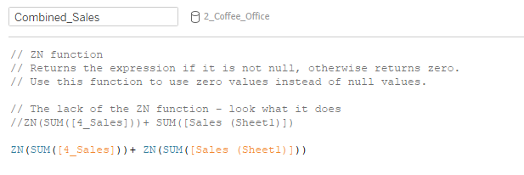
Exercise
Create a calculated field: for each state, calculate combined sales from office city.xlsx and coffee chain.xlsx
Notes:
Illustrate how the sales figure from the 2 different data sets can be combined based on the state name.

Slide 56
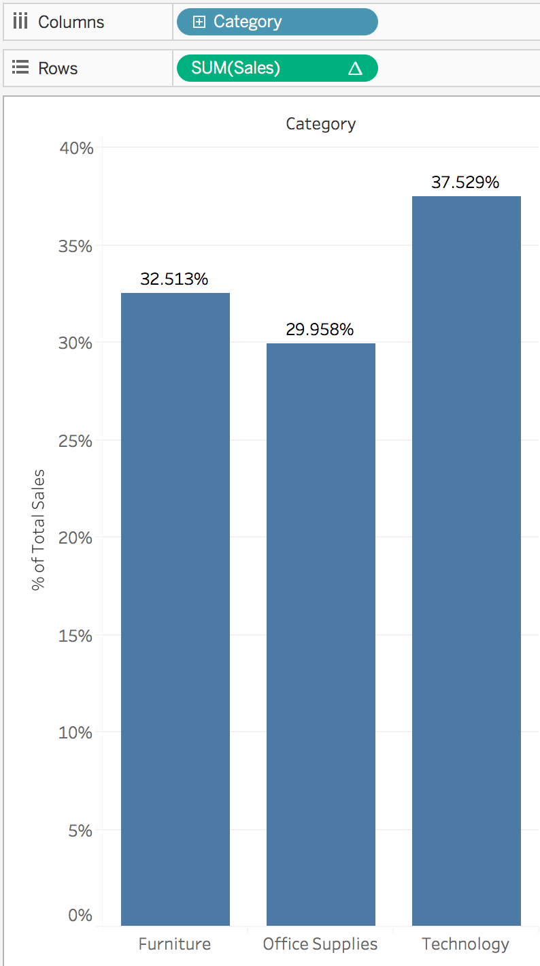
Quick Table Calculation
percent of total
Notes:
Make use of global_superstore_2016.xlsx (orders) for this exercise to guide students on the use of quick table calculation.
Go to “Rows” and select drop down menu of “Sum(sales)”.
Select “Add Table Calculation” and change Calculation Type to “Running total”.

Slide 57
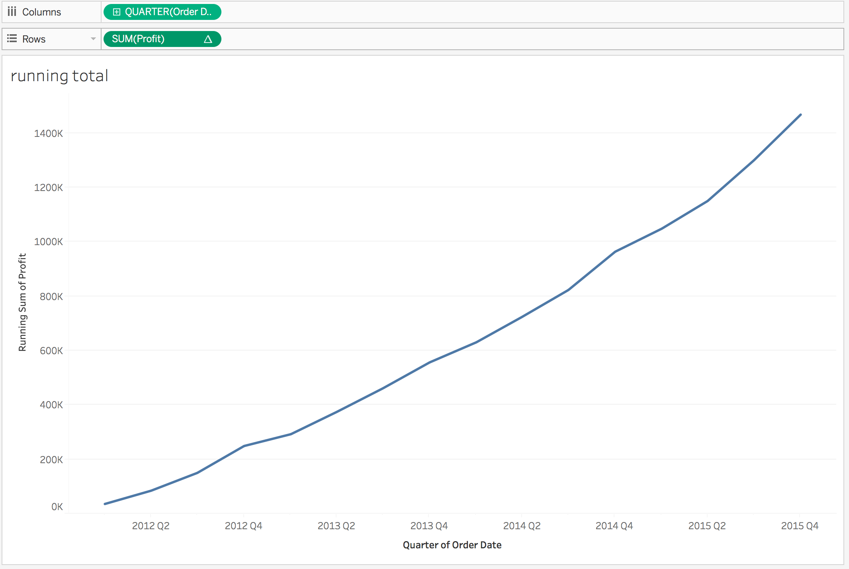
Quick Table Calculation
running total

Slide 58
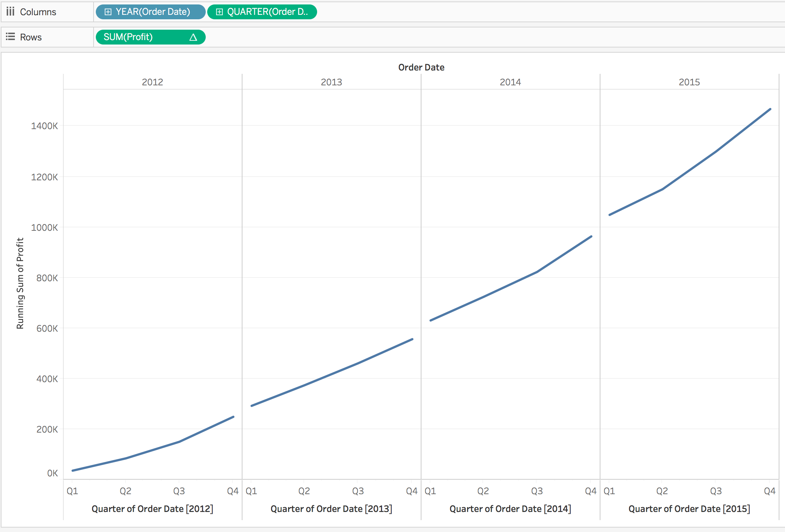
Quick Table Calculation
running total for each year: Is this chart correct?

Slide 59
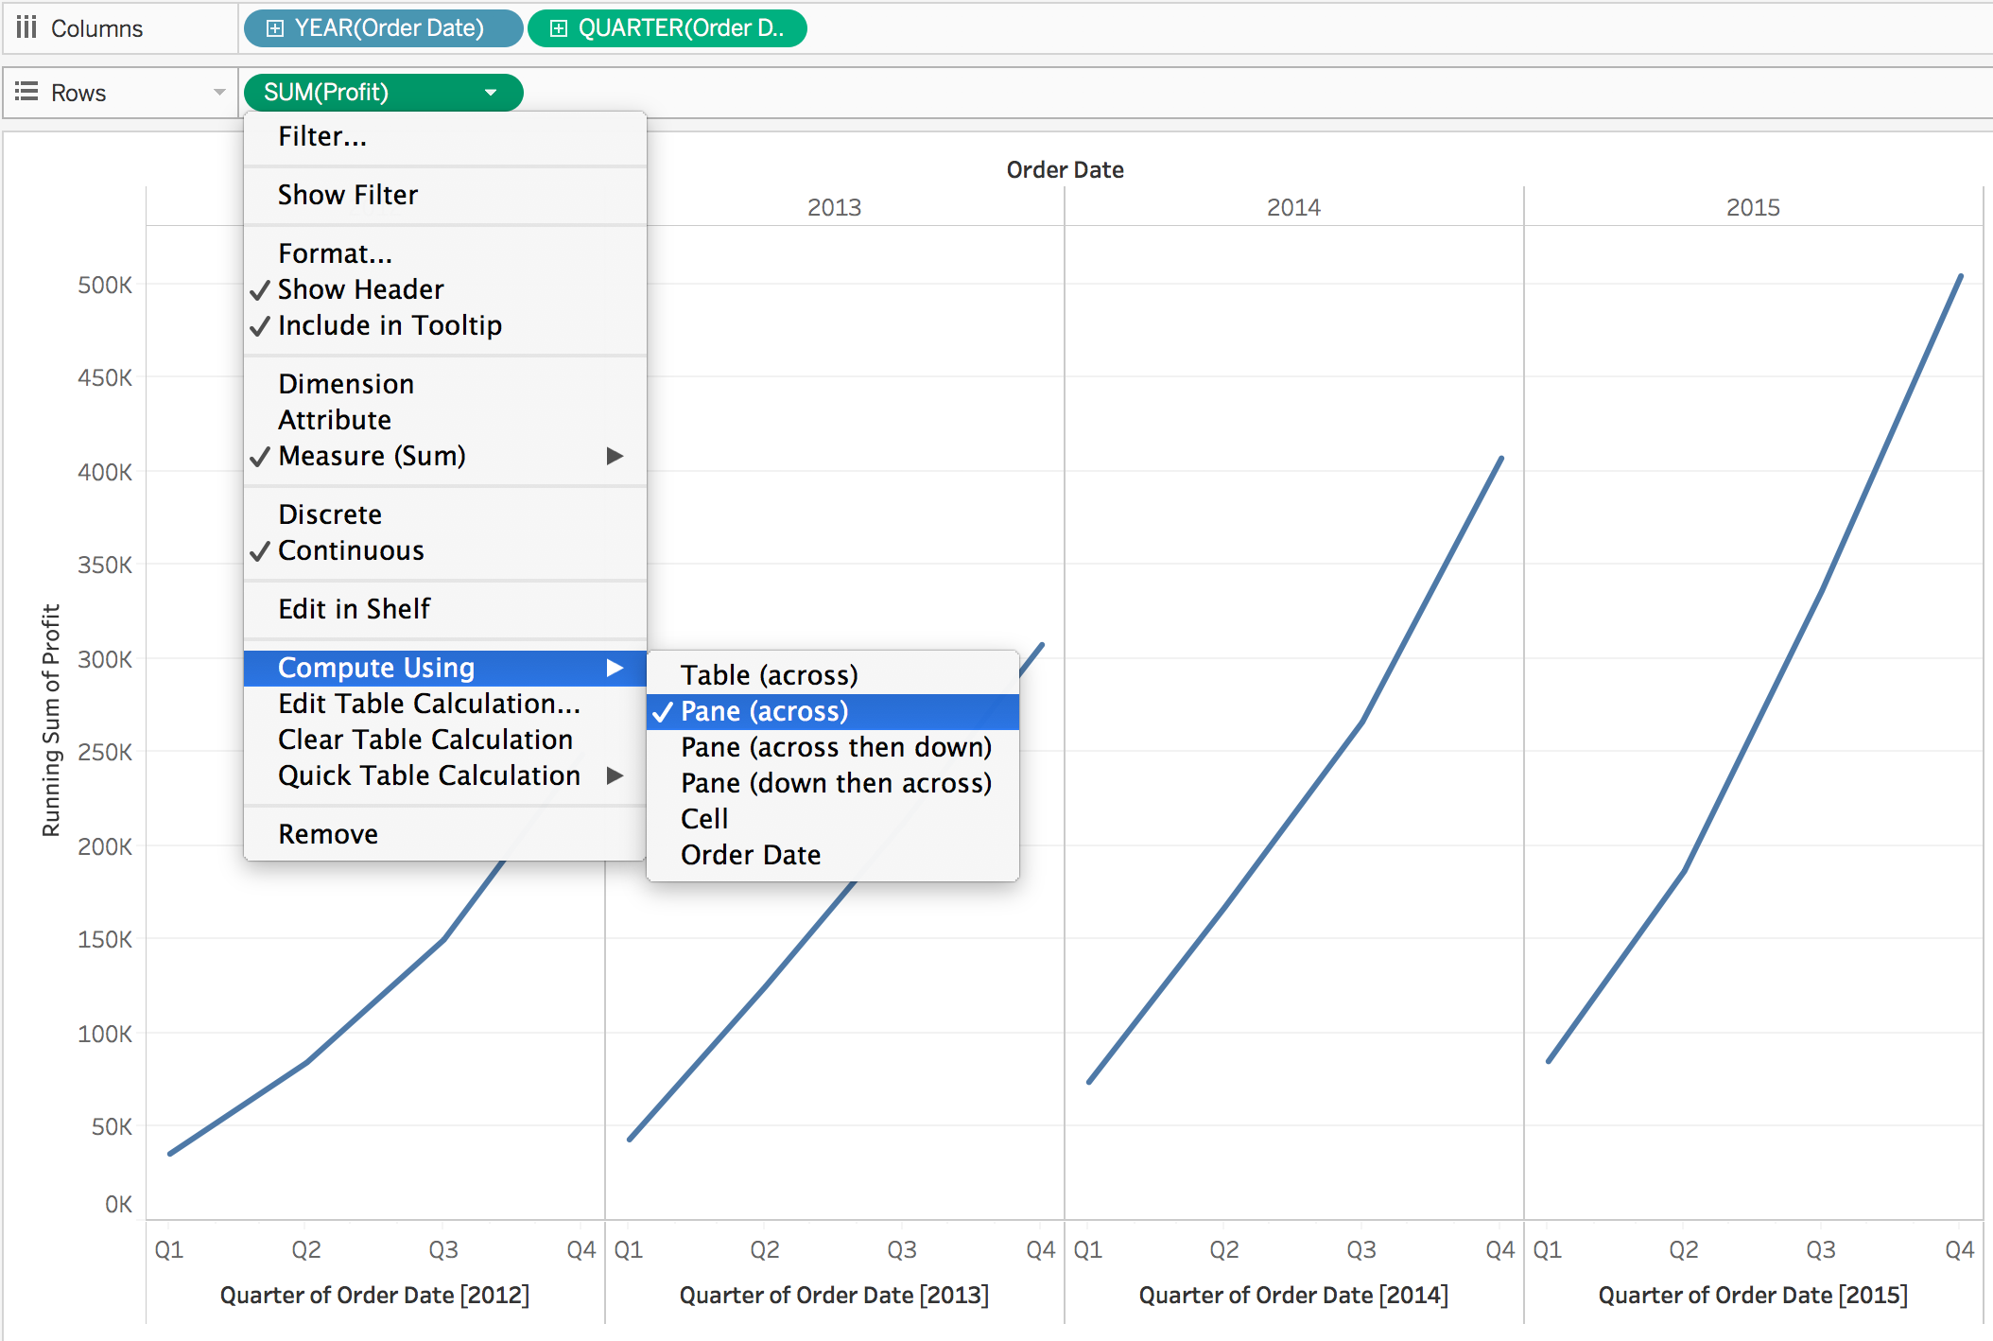
Quick Table Calculation
running total for each year:
Notes:
Illustrate the differences between the different options under “Compute Using”

Slide 60
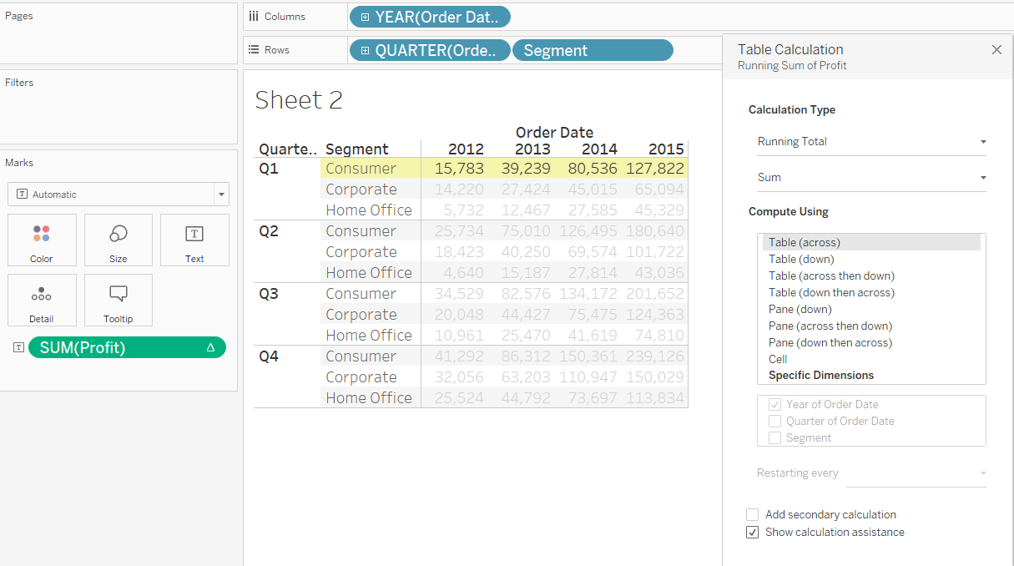
Quick Table Calculation
Compare “Compute Using”:
Notes:
Illustrate the differences between the different options under “Compute Using”

Slide 61
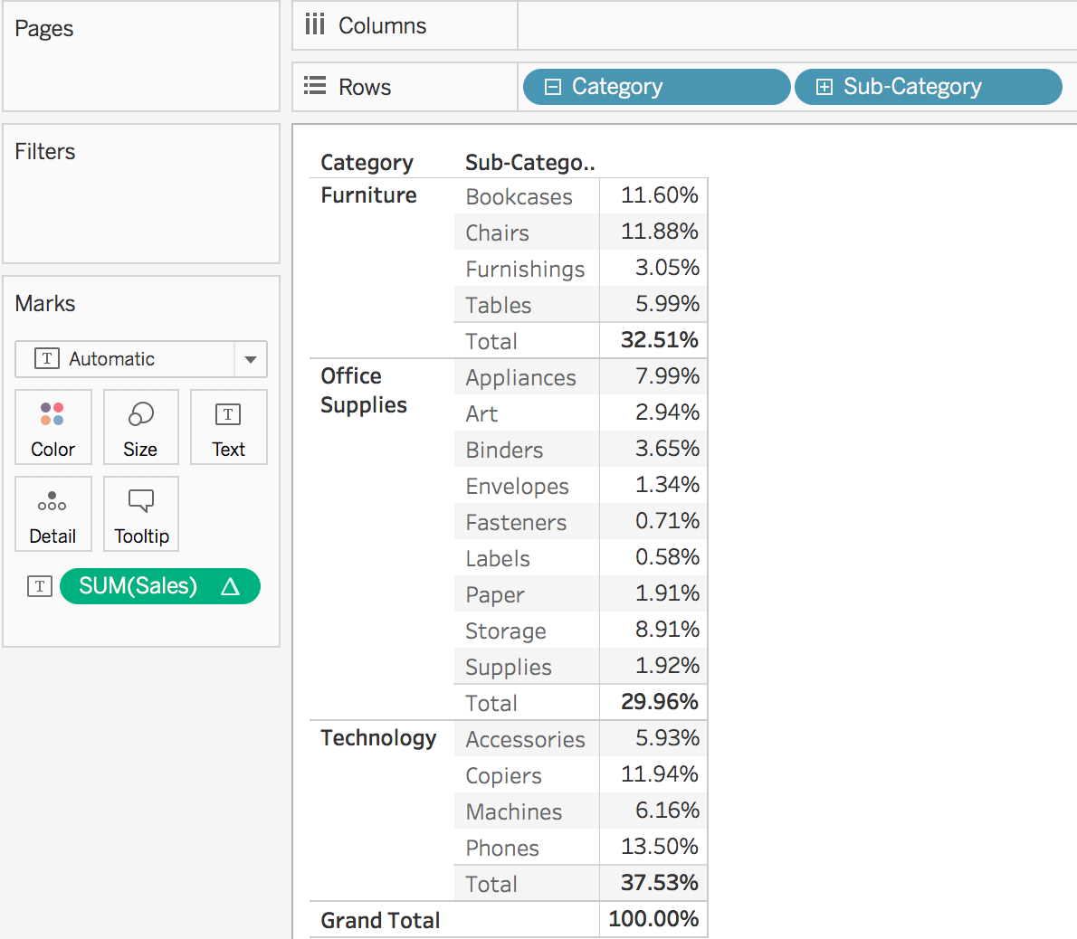
Quick Table Calculation
More Information:
https://help.tableau.com/current/pro/desktop/en-us/calculations_tablecalculations.htm

Slide 62
Course Homepage | https://canvas.suss.edu.sg/courses/31564
Study Guide | https://ibookstore.suss.edu.sg/
Tableau Desktop | https://www.tableau.com/products/trial
Tableau Tutorials | https://www.tableau.com/learn/get-started/creator
Academic Calendar | https://www.suss.edu.sg/docs/default-source/contentdoc/oas/pt-2021acadcalendar.pdf

Slide 63
Tableau Desktop System Requirements
Windows
Windows 7 or newer (64 bit)
Intel Pentium 4 or AMD Opteron processor or faster
2 GB memory
1.5 GB minimum free disk space
Mac
iMac/MacBook computers 2009 or newer
macOS High Sierra 10.13 and macOS Mojave 10.14
1.5 GB minimum free disk space
Notes:
Get licenses for students at https://www.tableau.com/academic/teaching/course-licenses

Slide 64
Tableau Prep Builder System Requirements
Windows
Windows 7 or newer (64 bit)
Intel Core i3 or AMD Ryzen 3 Pro or faster
4 GB memory
2 GB minimum free disk space
Mac
macOS High Sierra 10.13 and macOS Mojave 10.14
Intel Core i3 or faster
4 GB memory
2 GB minimum free disk space

